Slide 1
LAST WEEK BANK NIFTY SPOT DID OUR TARGETS 32680 MADE HIGH 32719. NOW BANK NIFTY TRADE BELOW 32K ONLY CAN SEE www.ritapandit25.in 31880-31750-31500-31K-30500-30K LEVELS ON DOWN SIDE. TRADING ABOVE 32700 ONLY CAN SEE -32900-33K-33500-34K LEVELS ON UPSIDE.
BANK NIFTY WEEKLY PREDICTION
FOR 18/01/2021
BANK NIFTY OPTION FOR 18/01/2021:
HOI AT 32500 CE AND AT 32K PE.
BUY 32500 CE 21 JAN @358 STOP 328 TGT 380-410-445-500-530-600.
BUY 32200 PE 21 JAN @436+ STOP 390 TGT 458-490-530-570-600-750.
PE TO BUY BELOW 32100 BNS AND CE ABOVE 32510 BNS.
PANDIT INVEST

Slide 2
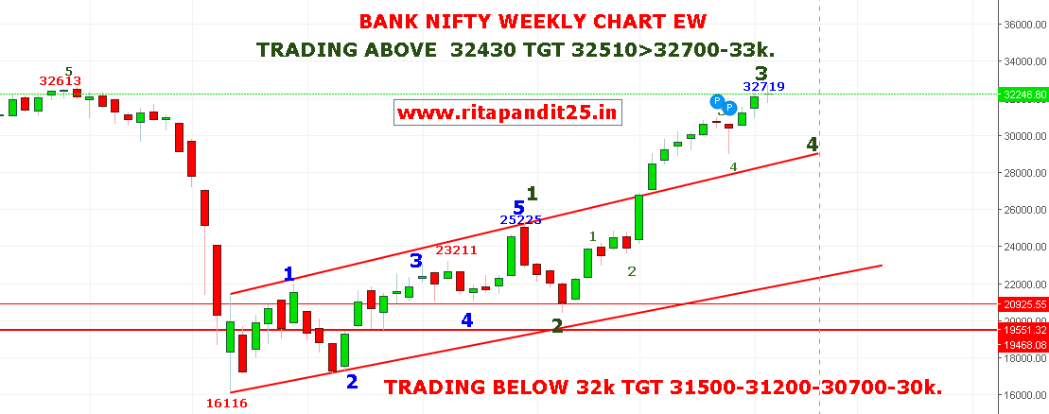
18-JAN-2021
TELEGRAM: PANDITINVEST www.ritapandit25.in 9831695525 Twitter@PredictionNifty facebook@niftyprediction.
Email: panditinvest@gmail.com.

Slide 3
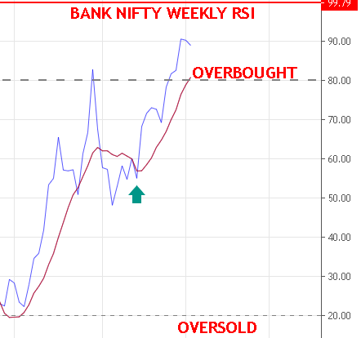
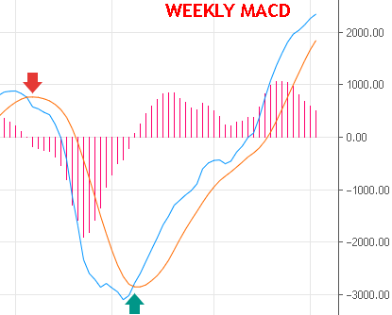

Slide 4
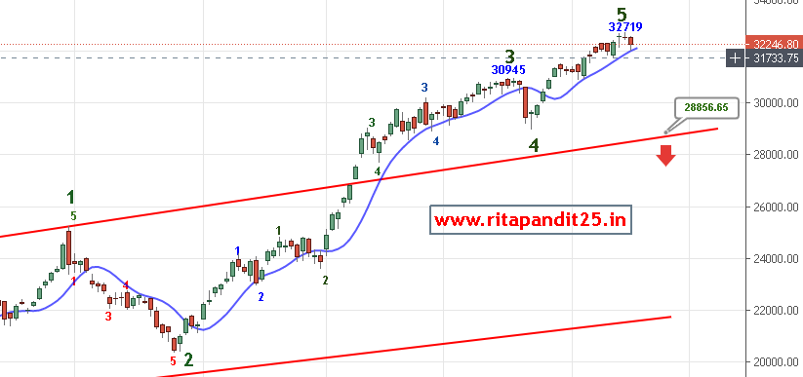

Slide 5
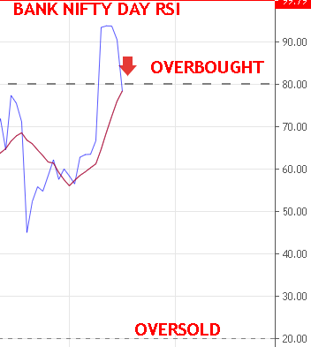
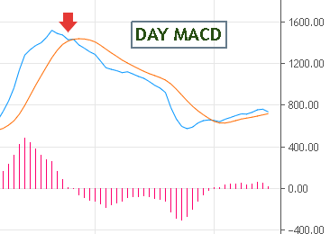

Slide 6
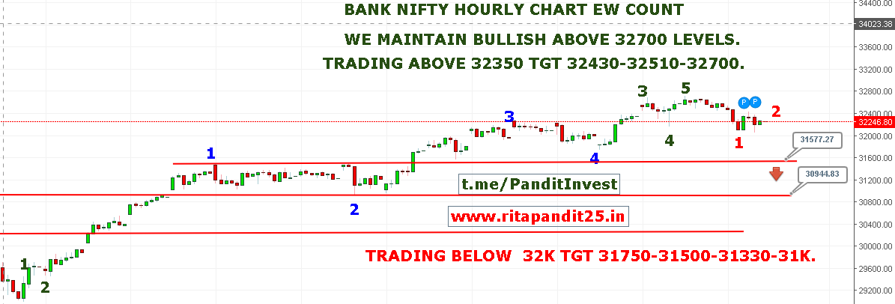

Slide 7
